Slide 1

Sol Efroni The Systems Biomedicine Lab systemsbiomed.org The Mina & Everard Goodman Faculty of Life Sciences, Bar-Ilan University
Welcome to the
Can we see the tree for the woods?:
Different ways to look at multi million populations of T cell and B cell clones from high throughput immune sequencing data
Uri Hershberg The Systems Immunology Lab School of Biomedical Engineering, Science and Health Systems;
Department of Microbiology and Immunology, College of Medicine,
Drexel University

Slide 2
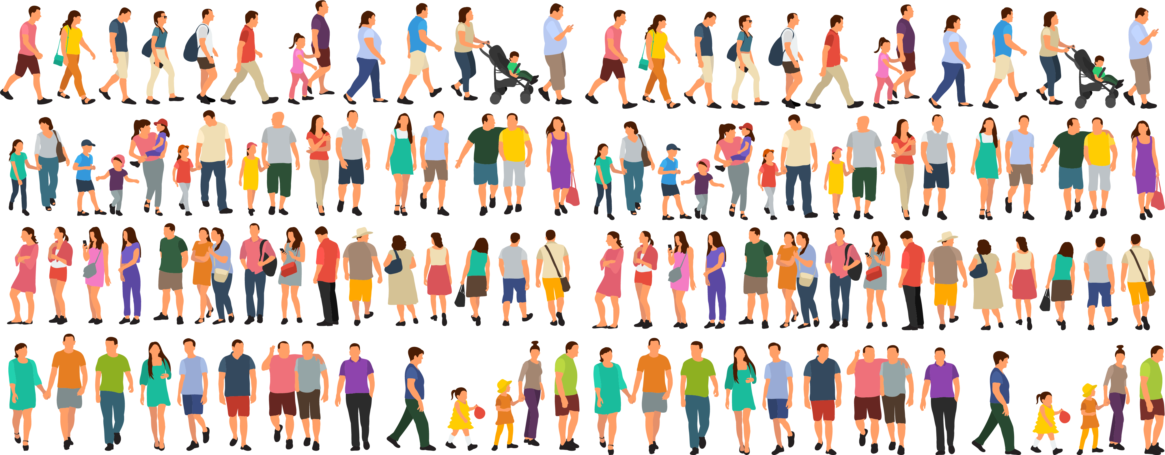

Slide 3
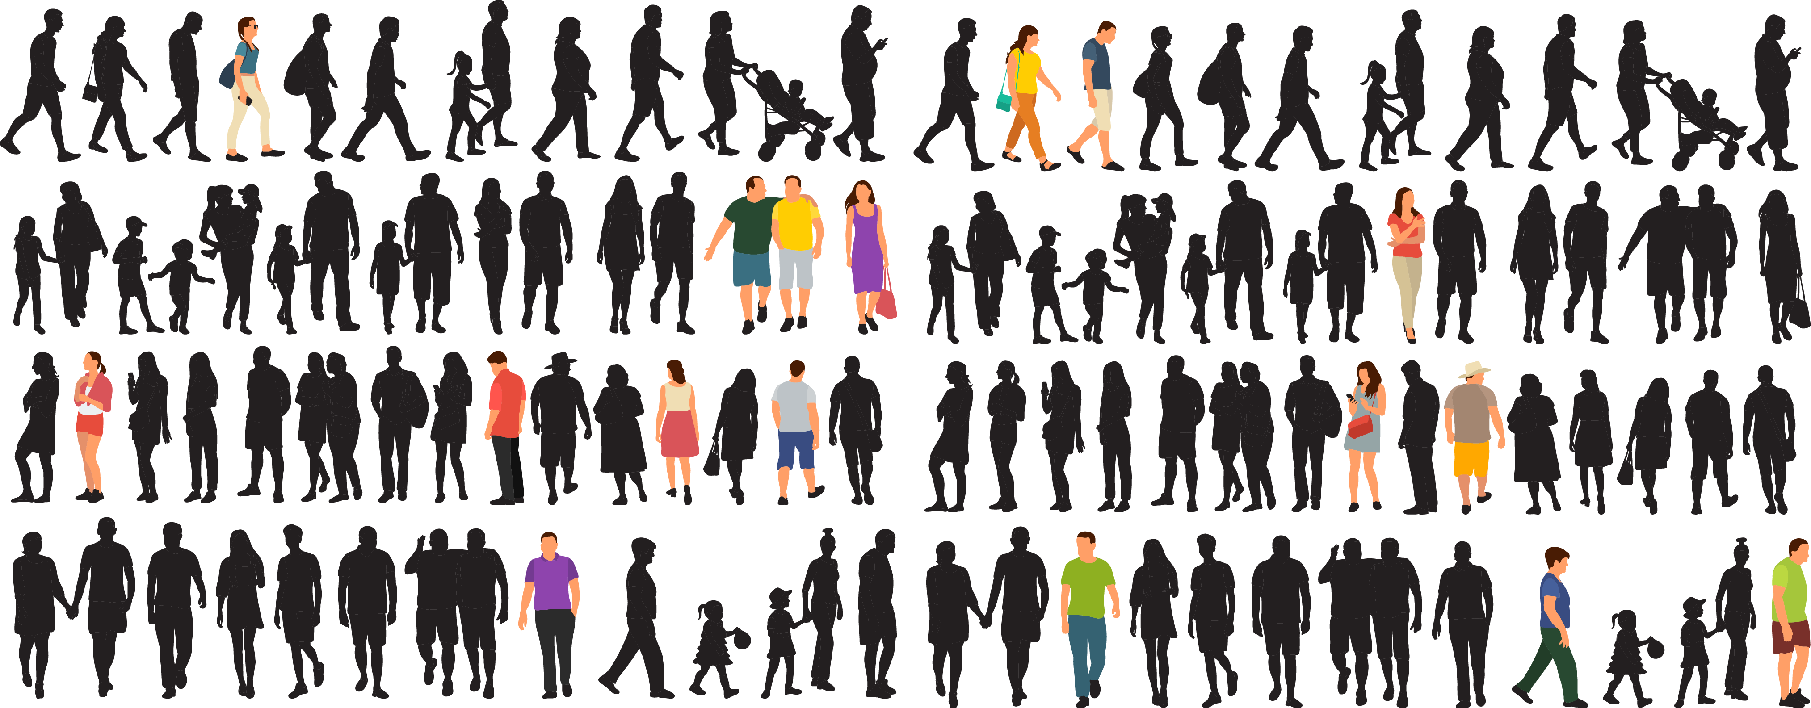
Responders/ Non-responders
Healthy tissue/ Tumor tissue
Phenotype A/ Phenotype B

Slide 4
How do we create an interactive visualization of the diversity of a population taking into account the different known characteristics of the individuals that build it. Allowing for:
Clearer identification of important determinants of diversity.
Unsupervised identification of sub populations.
How do we create an interactive visualization of the comparison of two populations. Creating both:
Pairwise comparisons
Multiple characteristic comparisons / comparison of dependent characteristics

Slide 5
Some examples of interactive visualizations of the diversity of a population taking into account the different known characteristics of the individuals that build it.
Selfie exploratory
The demographics of others
Comparing time courses or parameters in time
Life expectancy by wealth across the years
The American workday
Notes:
https://blog.udacity.com/2015/01/15-data-visualizations-will-blow-mind.html

Slide 6
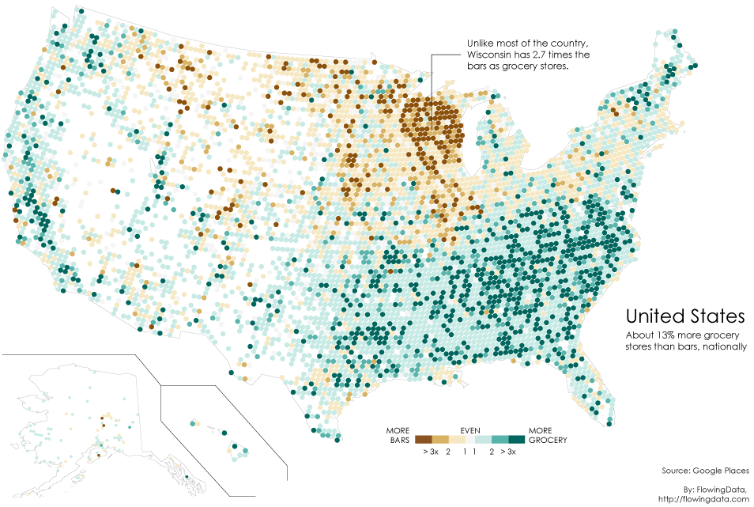
Unsupervised identification of sub populations.
Notes:
https://flowingdata.com/2014/05/29/bars-versus-grocery-stores-around-the-world/

Slide 7
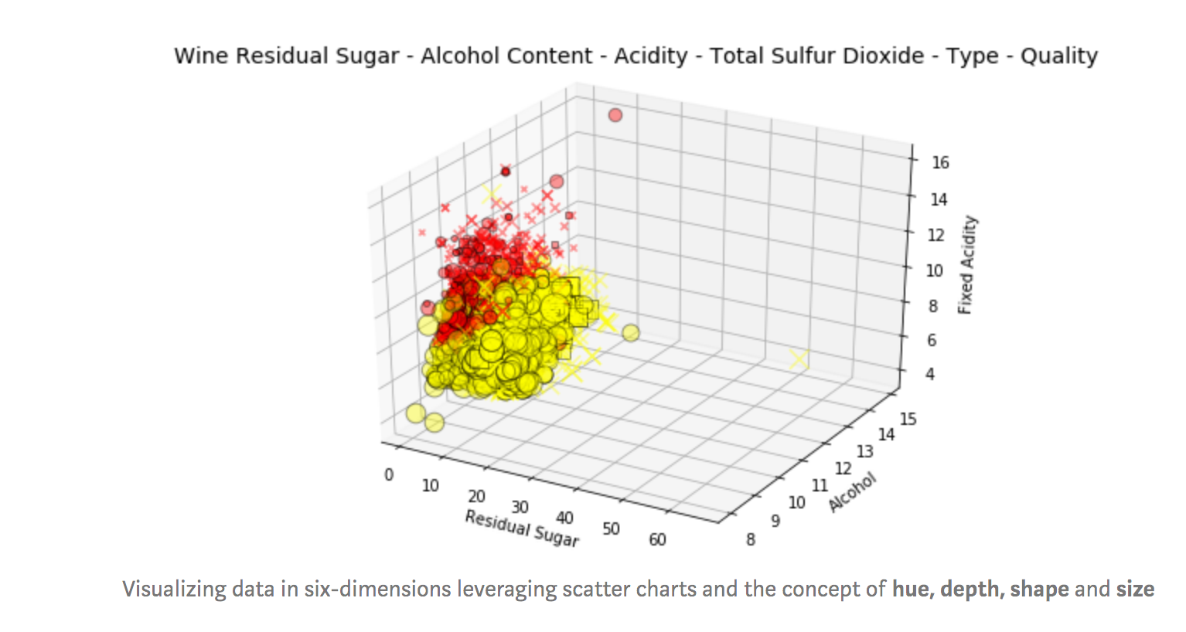
Multiple characteristic comparisons
https://towardsdatascience.com/the-art-of-effective-visualization-of-multi-dimensional-data-6c7202990c57
Pairwise comparisons
http://selfiecity.net/#selfiexploratory
Notes:
Wow that is six dimensions in one plot! We have wine quality_label depicted by shapes, high (the squared pixel), medium (the X marks) and low (the circles) quality wines. The wine_type is represented by hue, fixed acidity by the depth and data point size represents total sulfur dioxide content.
Interpreting this might seem a bit taxing but consider a couple of components at a time when trying to understand what’s going on.
Considering shape & y-axis, we have high and medium quality wines having higher alcohol levels as compared to low quality wines.
Considering hue and size, we have higher content of total sulfur dioxide for white wines as compared to red wines.
Considering depth and hue, we have white wines having lower fixed acidity levels as compared to red wines.
Considering hue and x-axis, we have red wines having lower levels of residual sugar as compared to white wines.
Considering hue and shape, white wines seem to have more high quality wines as compared to red wines (possibly due to larger sample size of white wines).

Slide 8
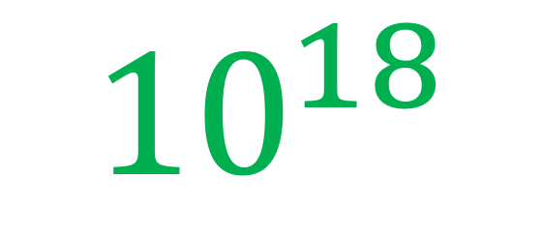
$${10}^{18}$$

Slide 9


Slide 10

2 million T cells

Slide 11
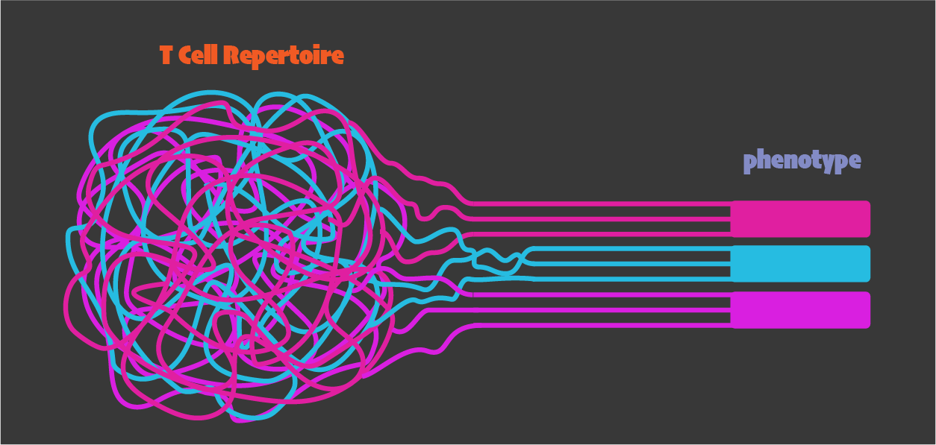

Slide 12
What is the unit of selection(s)?

Slide 13
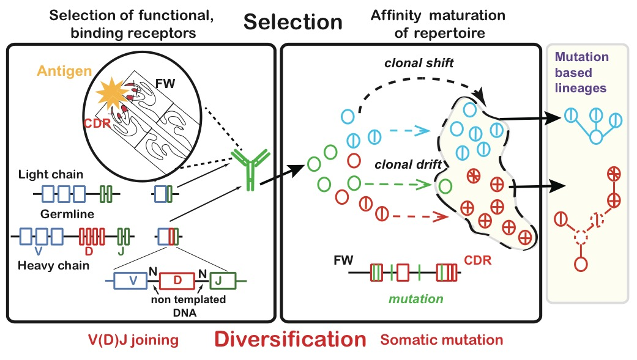
Lineages allow us to capture process

Slide 14
How big is a clone?
Sample libraries | Unique sequences | Unique instances | Copies
3 | 4 | 6 | 9
How big
Is Clone i?
Notes:
Put in cartoon examples ?

Slide 15
How mutated is a clone?
Total mutations | Unique mutations | Average by instances | Average by Copies
12 or 18 | 4 | 12/6=2 | 18/9=2
How mutated
Is Clone i?
Notes:
To this we can add also types of mutations.
What regions of the gene they are in? CDR and FWAR
What kind they are?

Slide 16
How do we create an interactive visualization of the diversity of a b cell population
Grouped by germline V gene, by CDR3 amino acid sequence, by metadata (tissue type, disease state etc.)….
Unsupervised Identification of sub populations of B cells
How do we visualize multiple clones and multiple clone members at the same time?
How do we create an interactive visualization to compare b cell populations
Pairwise comparisons
Multiple characteristics comparison / comparison of hierarchical dependencies
By disease state or tissue type (With multiple dependencies)
Over time.

Slide 17
How do we visualize the effects of B cell specificity (which we know from the B cell receptor sequence) on other B cell population characteristics?
Notes:
How do we visualize clone population patterns related to non B cell receptor features of the B cell populations (Time point, disease, cell type, tissue, species, etc.)?
How do we visualize changes of B cell characteristics within clones?
How do you visualize changes and relationships of B cell characteristics/metadata across lineages?
How do you visualize differences in lineage shapes across populations of clones?

Slide 18
Creating a map of B cell clones in the human body
(1) How can we estimate clonal overlap between tissues?
8 tissues
PBL
BM
SPL
Lung
MLN
Jejunum
Ileum
Colon
Notes:
Do clones overlap across tissues and expand in a consistent way?

Slide 19
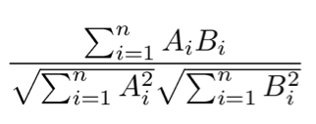
Cosine similarity of clones found in tissues
Tissue 1 | Tissue 2 | Tissue 3
Clone 1 size | Clone 1 size | Clone 1 size
Clone 2 size | Clone 2 size | Clone 2 size
… | … | …
Clone N size | Clone N size | Clone N size
If we are comparing tissue i and tissue ii to tissue iii
And there are N clones in the entire person

Slide 20
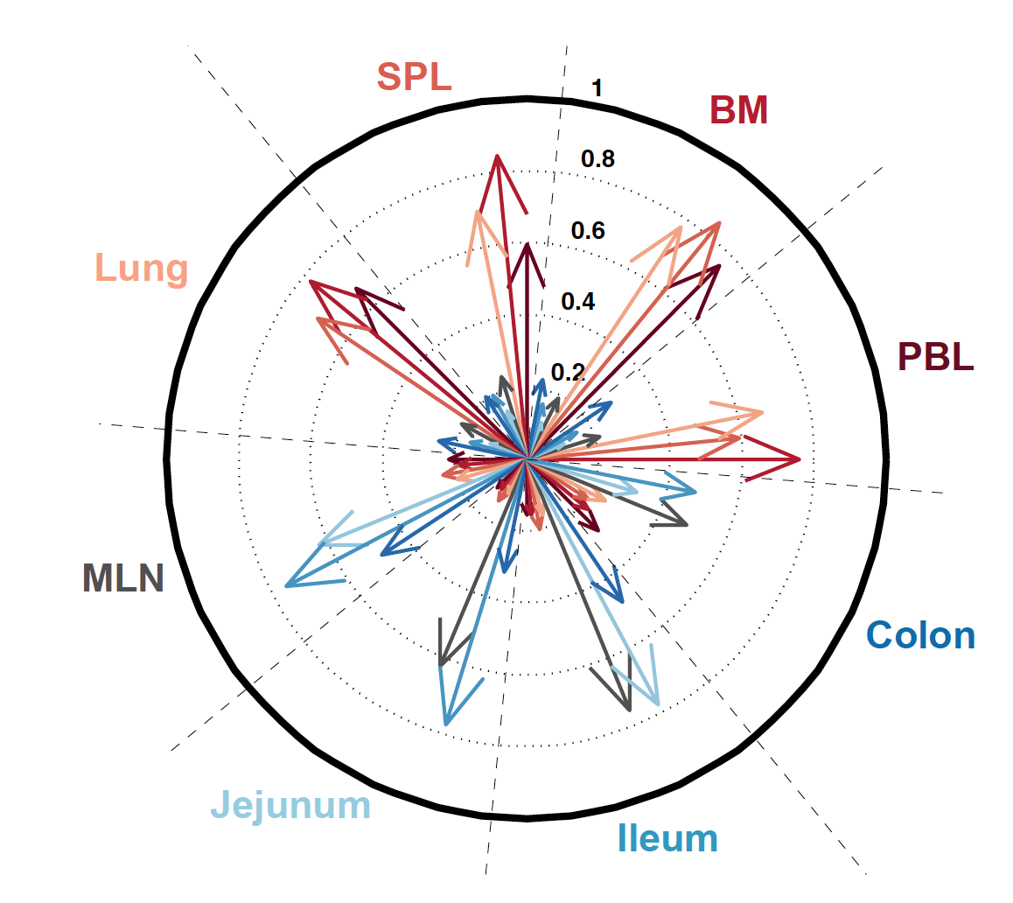
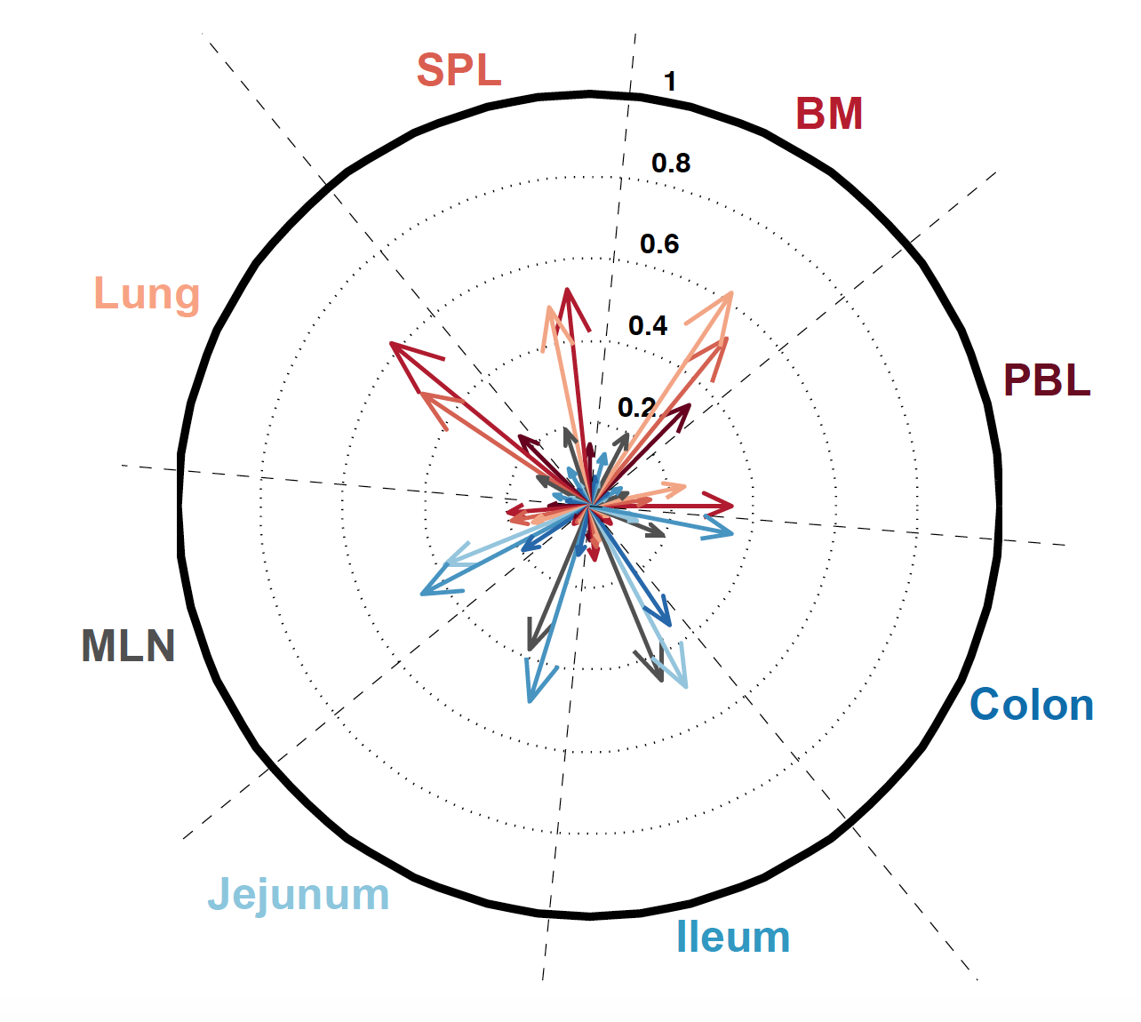
Gut clones are segregated from blood clones
Pairwise comparison –
unsupervised identification of sub populations
Donor
D181 C₂₀
Donor
D207 C₂₀

Slide 21
What does the division between gut and blood look like with more than 2-tissue comparisons?
“global” clones
(in 6-8 tissues)
“regional” clones
(in 3-5 tissues)
Two-tissue clones
There are also many single tissue clones
8 tissues
PBL
BM
SPL
Lung
MLN
Jejunum
Ileum
Colon
Multiple characteristic comparison
Notes:
~ 100/600/800 3500

Slide 22
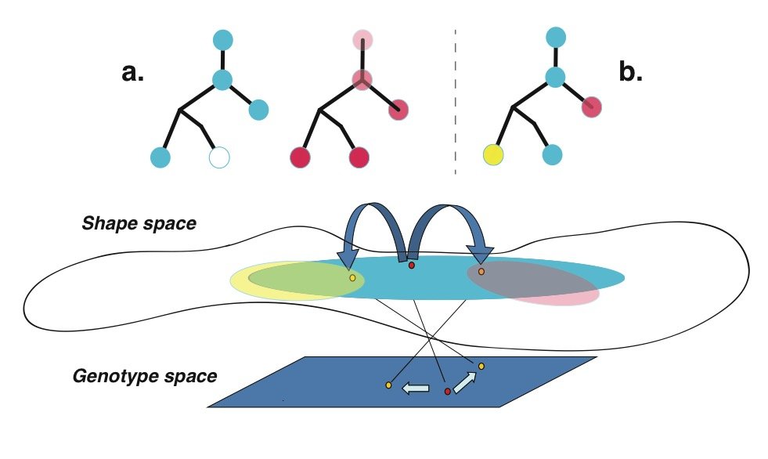
Even in the periphery is selection always driven by the same thing?

Slide 23
Creating a map of B cell clones in the human body
(2) How are sequence variants within clonal lineages distributed between tissues?
Notes:
Do clones overlap across tissues and expand in a consistent way?

Slide 24
How are sequence variants within clonal lineages distributed between tissues?
Are clones found in different tissues clumped together in lineage ?
Or evolving along separate branches?
Notes:
Trees are rooted in the closest germline VH gene allele in the IMGT database (see Methods). Numbers indicate somatic mutations. Circles are colored according to the tissue distribution of the sequence variants colored as in Fig 1. Circle sizes are proportional to sequence copy numbers. Black dots indicate inferred nodes. Each clone is identified by an unique identifier number in http://immunedb.com/tissue-atlas.

Slide 25
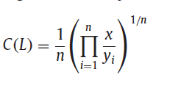

A novel clumpiness metric to measure mixing of mutants in a clone that are found in different tissues
C(L1,L2,)=1
C(L1,L1)=0; C(L12,L2)=0
C(L1,L2,)=0
C(L1,L1)=1; C(L12,L2)=1
Schwartz, G.W., Shokoufandeh, A., Ontanon, S., Hershberg, U. (2016) Using a novel clumpiness measure to unite data with metadata: finding common sequence patterns in immune receptor germline V genes Pattern Recognition Letters 74: 24-29

Slide 26
GI tract clones exhibit extensive sharing of sequence variants within clonal lineages
Inter tissue clumpines= 0
Inter tissue clumpines= 1
Visualizing multiple clones and the characteristics (in this case clumpiness) of individual clones
Pairwise comparison
Notes:
GI tract tissue clones exhibit extensive sharing of sequence variants. The median of the distribution of clumpiness values (a metric of sequence sharing within clonal lineages, see Methods)²⁵ is shown for all two-tissues pairs across all C₂₀ clones in D207. Clones with PBL and another tissue were the least mixed, followed by clones mixing blood and GI tract tissues, then blood tissue clones and finally GI tract clones were the most mixed.

Slide 27
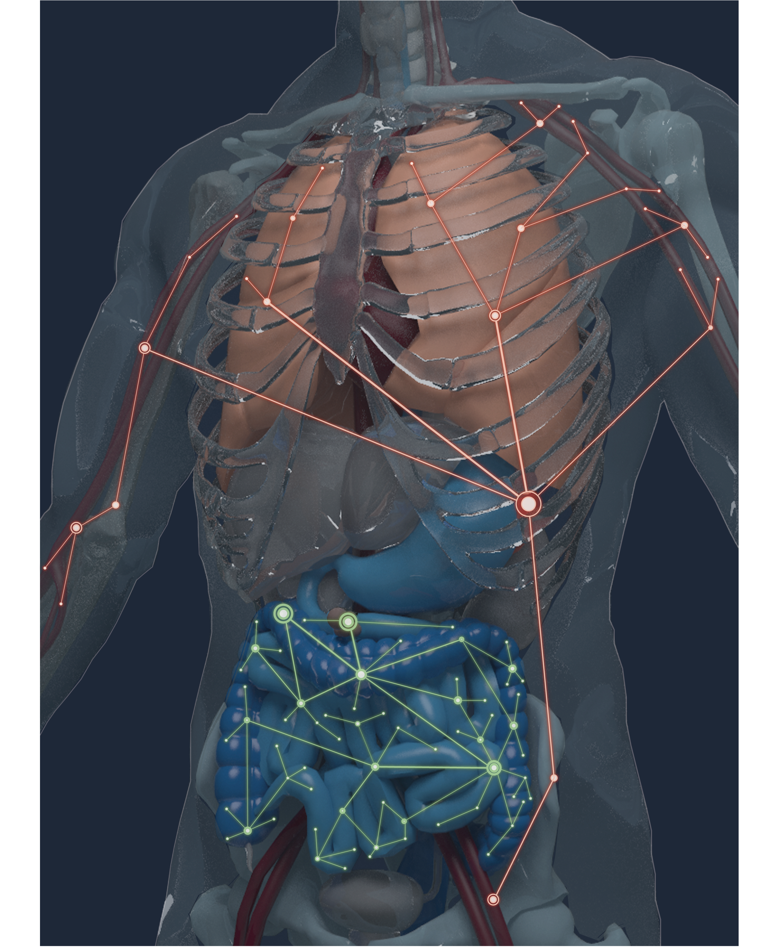
Conclusions
Humans have two large networks of expanded B cell clones
GI tract clones exhibit extensive intermingling between different portions of the tract
Tissue-based clones exhibit higher of SHM distributions

Slide 28
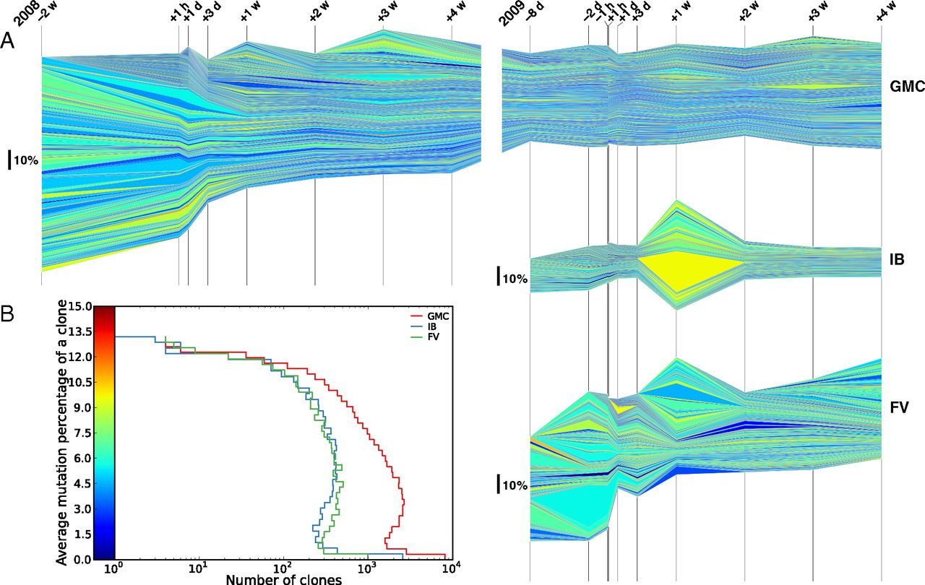

Vaccination clone dynamics colored by mutation.
Uri Laserson et al. PNAS 2014;111:13:4928-4933
Mutation rate
Over time.
©2014 by National Academy of Sciences
Notes:
Vaccination clone dynamics colored by mutation. (A) Each layer represents a clone. Time is shown by the grid lines on the x axis, and labeled relative to the two vaccination events. The thickness of each layer is proportional to the frequency of that clone at that time point. Each clone is colored based on the average mutation level of the corresponding reads (see color bar for B). Only clones seen in at least two time points are shown here. (B) Histogram of the average mutation level of all of the clones. Each clone is counted once (i.e., clones are not weighted by the number of corresponding reads). Stream graphs are stacked bar charts with moving baselines; if we did not filter out clones in only a single time point, the total thickness of the graph would add up to unity.

Slide 29
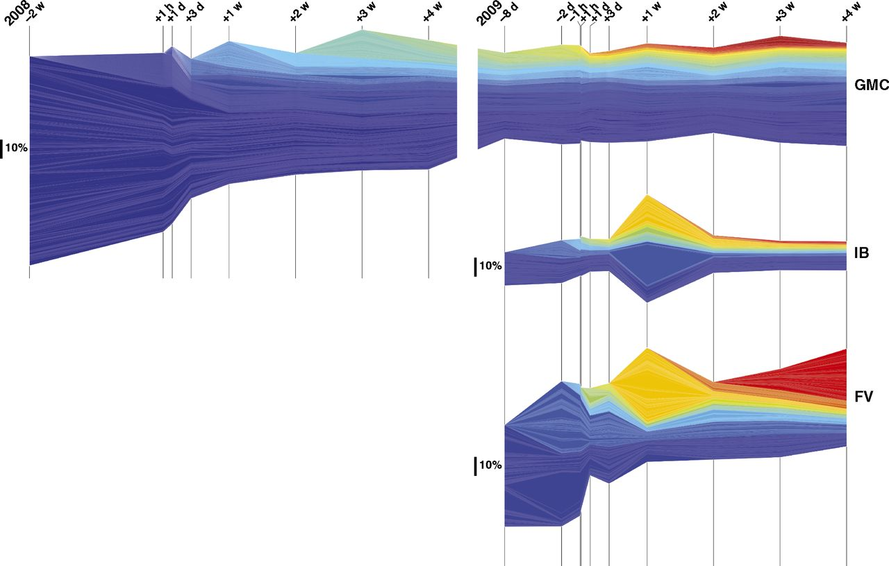
Vaccination clone dynamics colored by onset time.
Onset
Over time.
Uri Laserson et al. PNAS 2014;111:13:4928-4933
©2014 by National Academy of Sciences
Notes:
Vaccination clone dynamics colored by onset time. Same as Fig. 3, except clones are colored by onset time. Onset times are ordered spectrally, so that all clones seen in the first time points are blue, followed by cyan, etc.

Slide 30
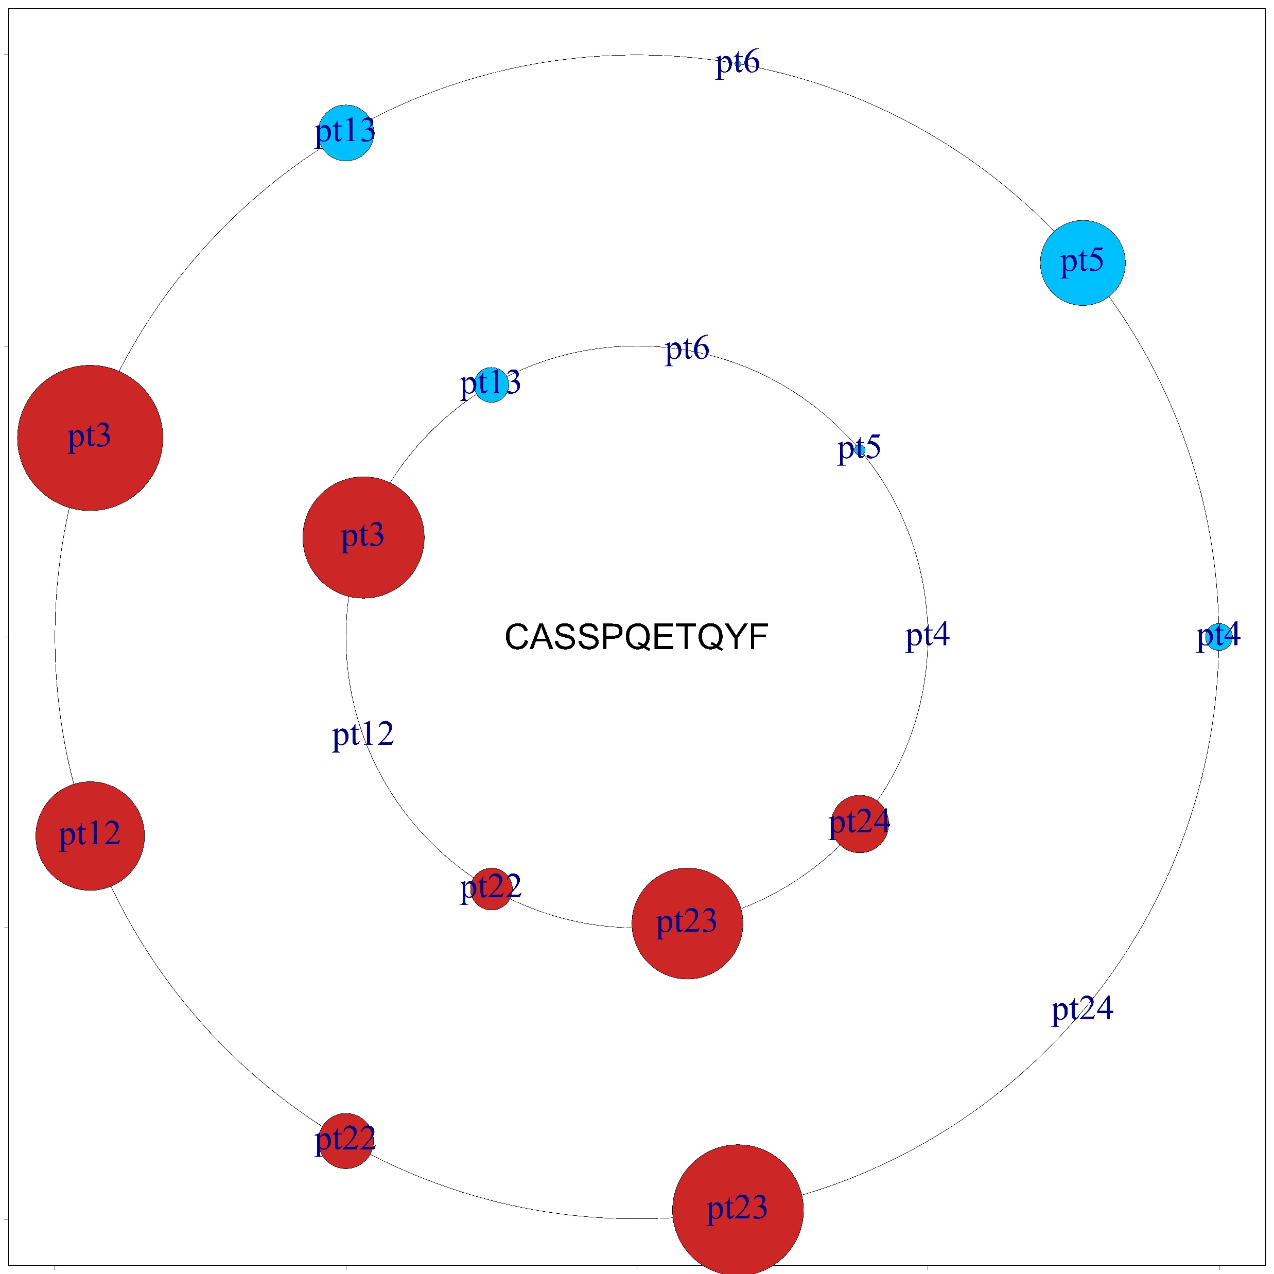
Grouped by CDR 3
Across people

Slide 31
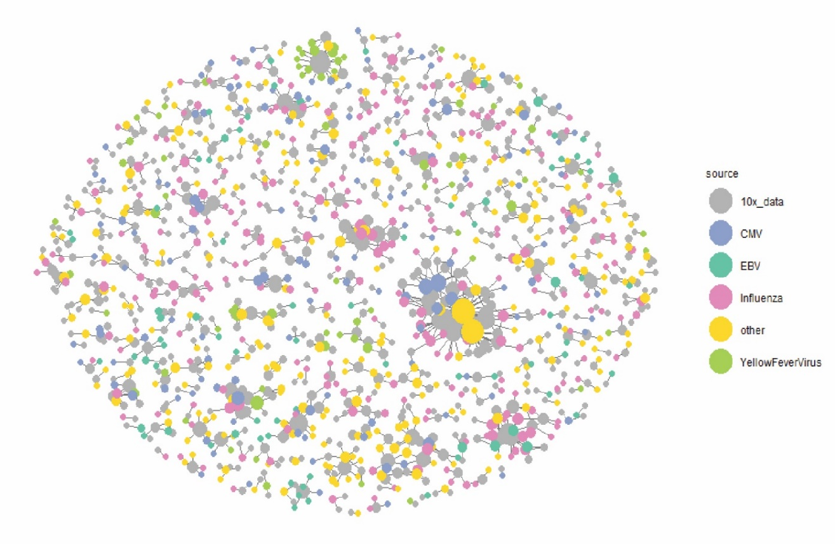
Unsupervised Identification of sub populations of T cells
10x scDATA analyzed for its viral TCR related clones

Slide 32
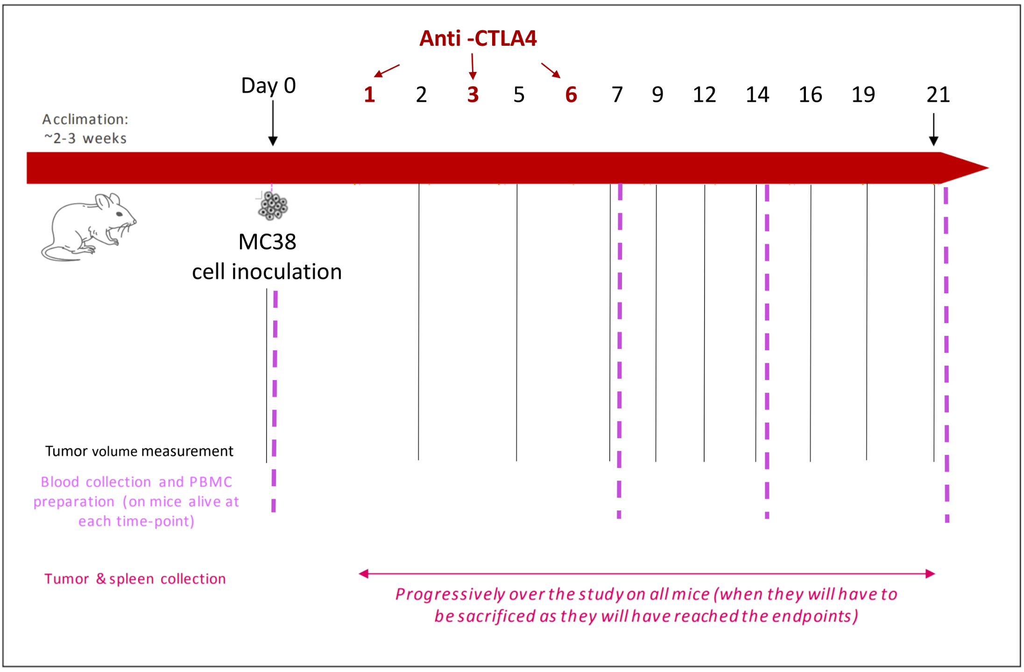
Notes:
We used a well-known cancer model.
20 mice were injected with tumors and given time to acclimate. At time point 0 the mice were inoclulated with MC38, and then our 15 treated mice were given Anti-CTLA4 over several days.
All mice were monitored over 21 days, where Tumor size was measured every 2 days, and blood taken every 7 days. After 21 days all remaining mice were sacrificed and tumor and spleen samples recovered.
This all left us with 120 data points and a way to track the changes in the repertoire over time.

Slide 33
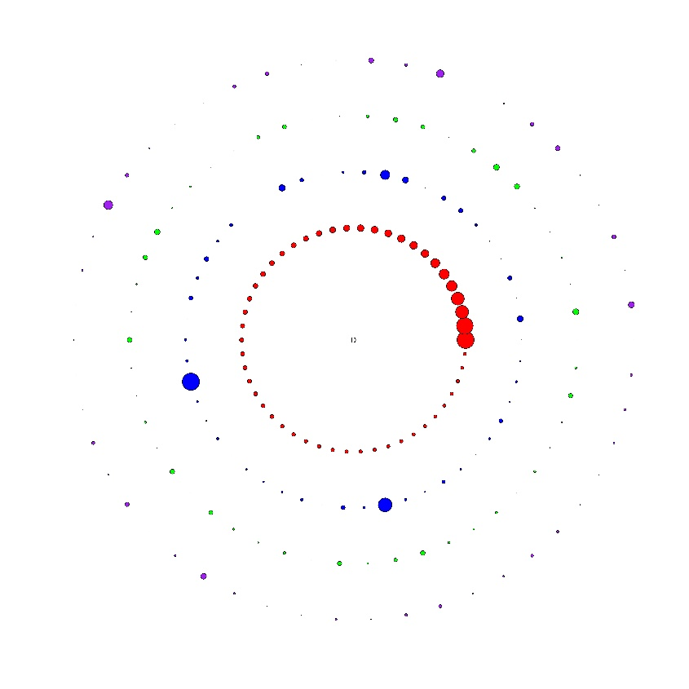
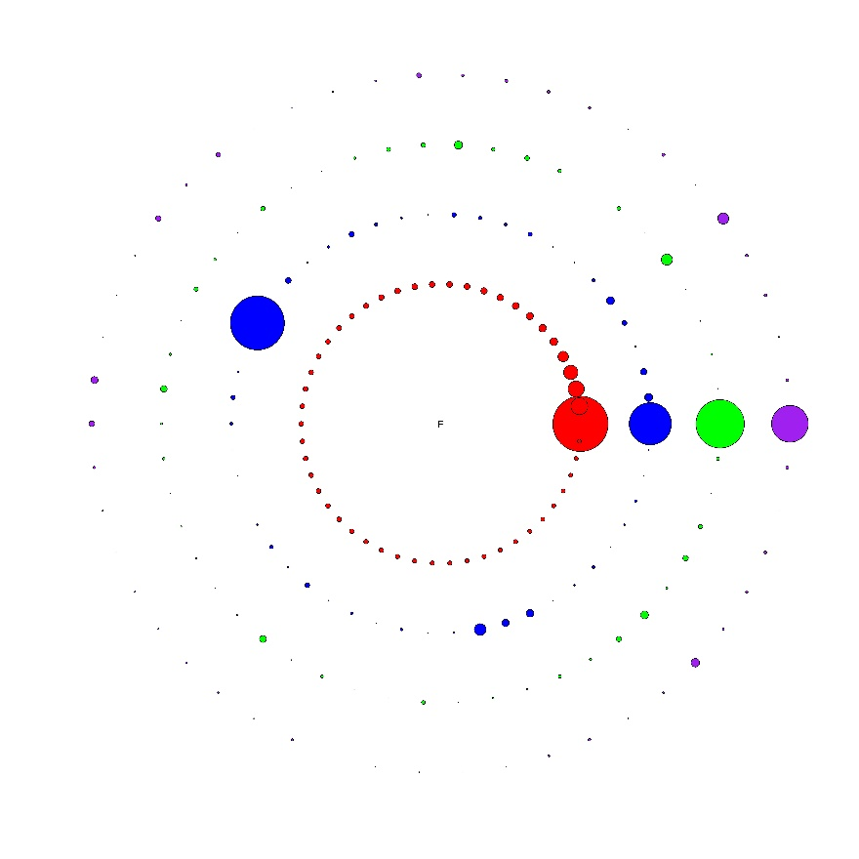
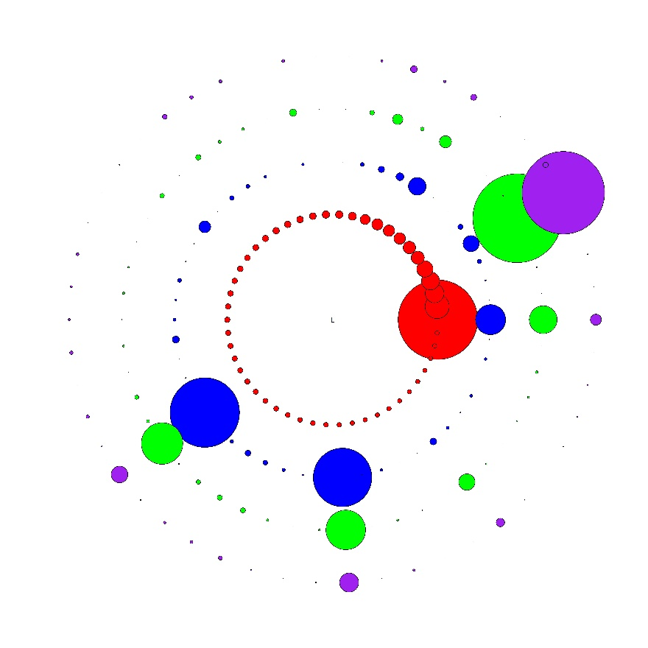
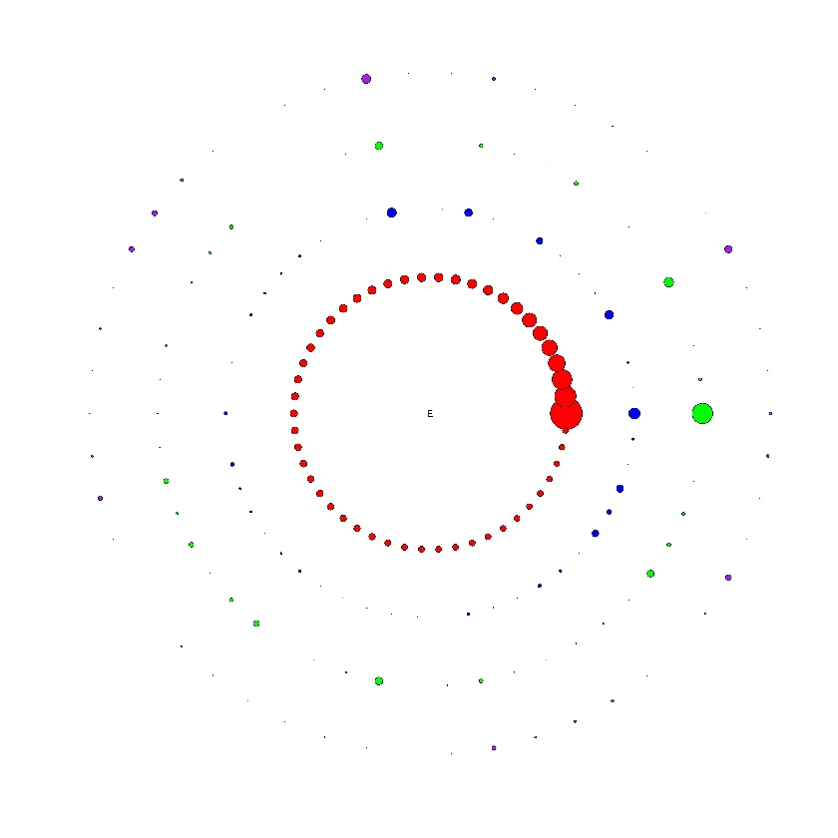
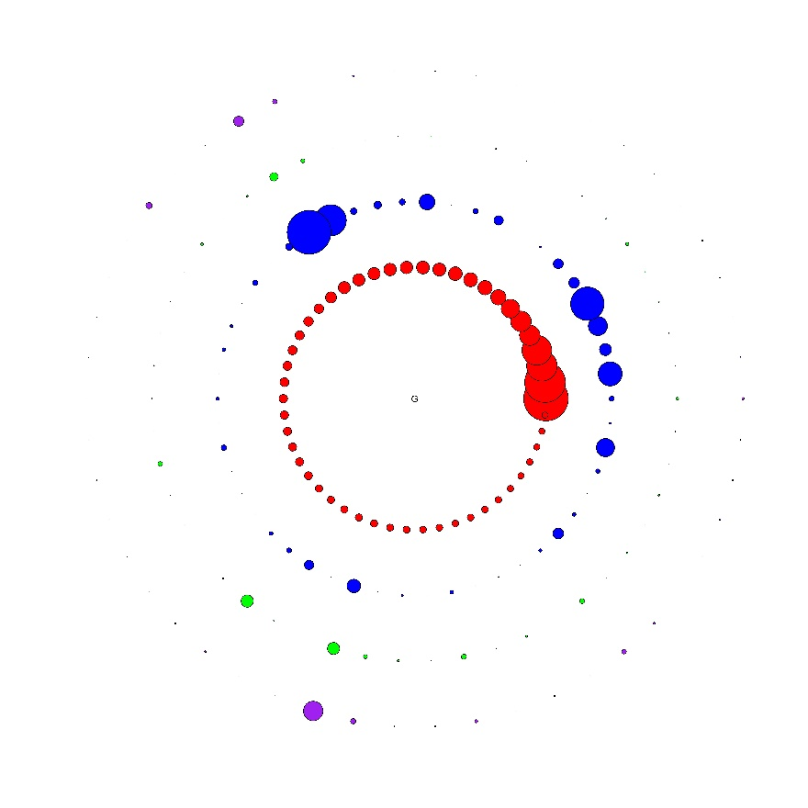
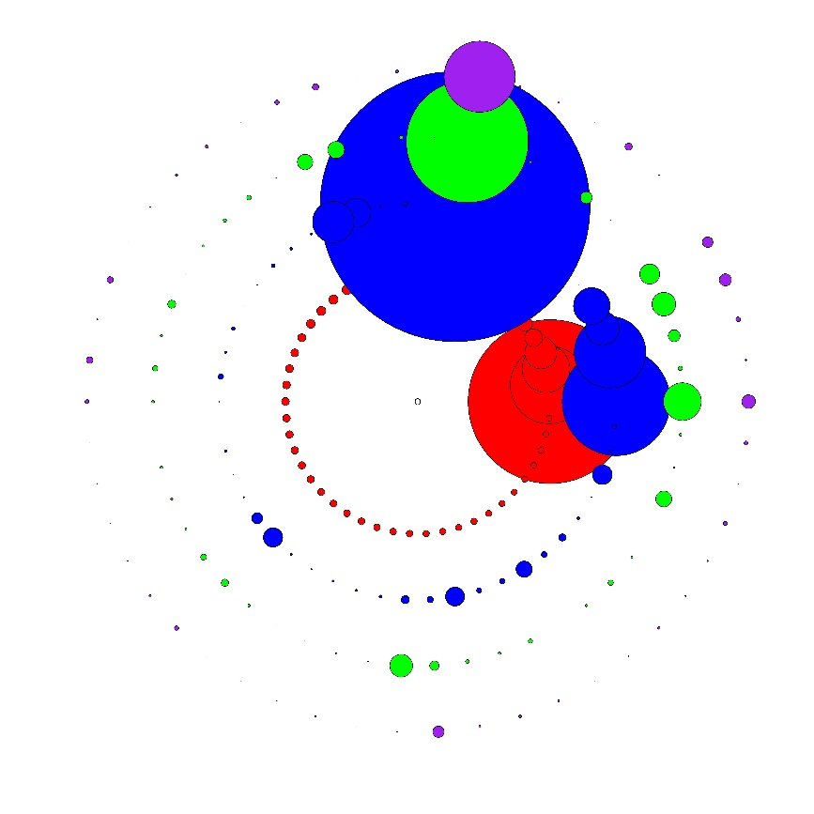
Visualizing multiple clones and multiple clone sizes over time
Control
Early responders
Late responders

Slide 34
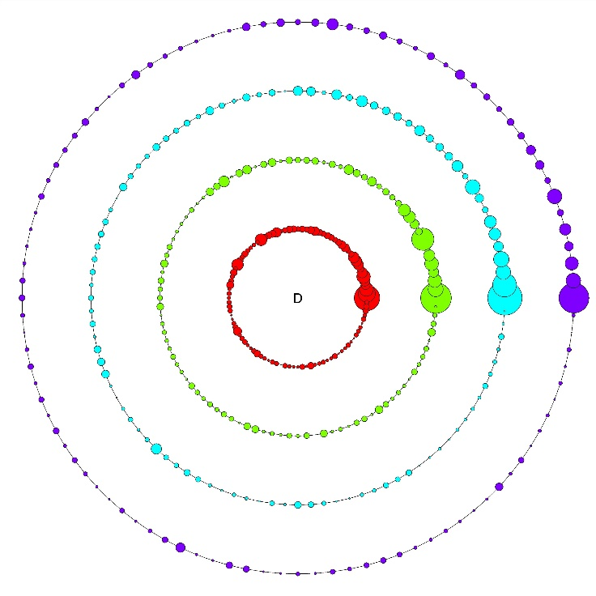
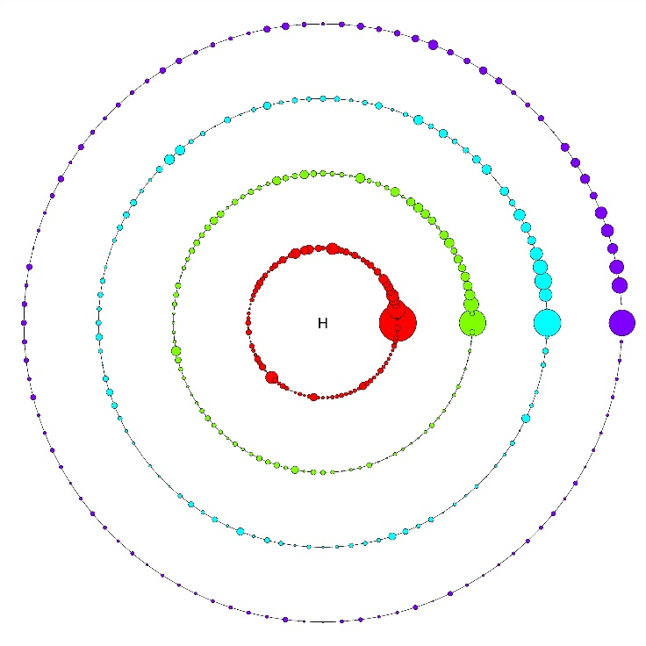
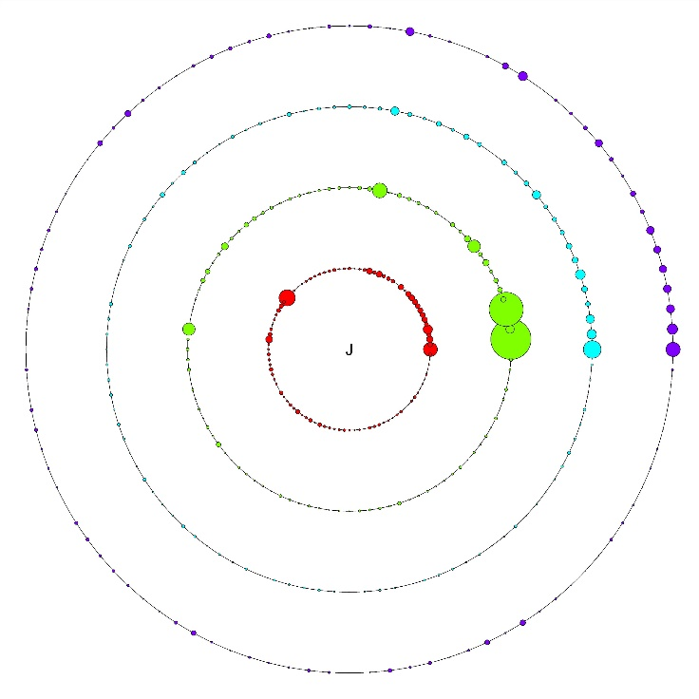
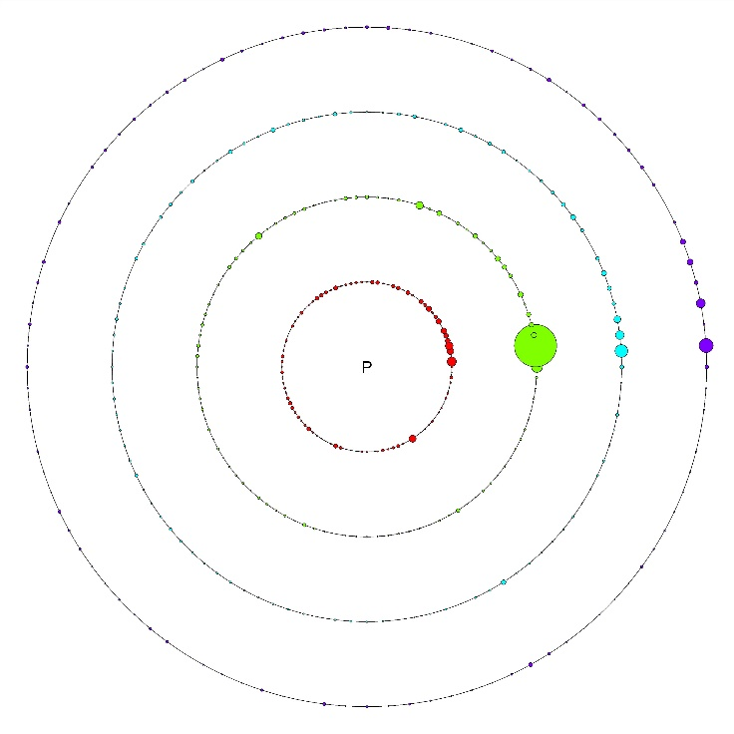
Grouping clones by size
Temporal dynamics of top 100 clones
Control
Late Responders
Mid Responders
Early Responders
Time point 0
Time point 7D
Time point 14D
Time point 21D
Visualizing multiple clones and multiple clone sizes over time

Slide 35
